Slide 1
CSSE 332 Filesystem(I)
Tuesday, January 8, 2019
Adapted from ND CSE 30341 Operating System Principles (Fall 2017)

Slide 2
Questions
What is a file?
What are the basic operations on a file?
How does OS facilitate file operations?
How to store files on storage – filesystem design?
How to identify the data that belong to a file?
Reference material: http://pages.cs.wisc.edu/~remzi/OSTEP/file-implementation.pdf

Slide 3
File basics
File: A named collection of related data stored on storage.
For a file, we can
Create
Open
Read
Write
Seek/Reposition
Delete

Slide 4
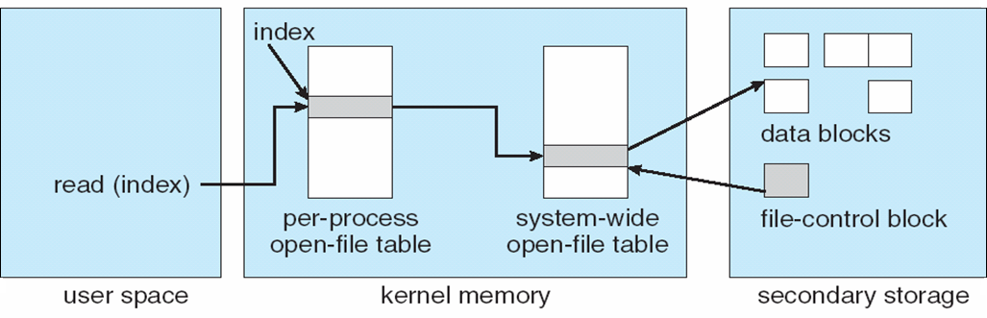
File Table
Given a file name, OS can help us operate on a file.
Via file table
How are files organized on the storage is the job of Filesystem.

Slide 5
Motivation: How to identify the data that belong to a file?
Assume we have a array with fixed size.
Now I have three strings with as shown below
Discussion Question:
Come up with certain rules/design that you can
Write the strings into array
So you can read them back as separated strings.
Further question: how to support appending?
string | size
Hello World! | 12
Aloha! | 6
0x01 0x02 0x03 0x04 | 4

Slide 6
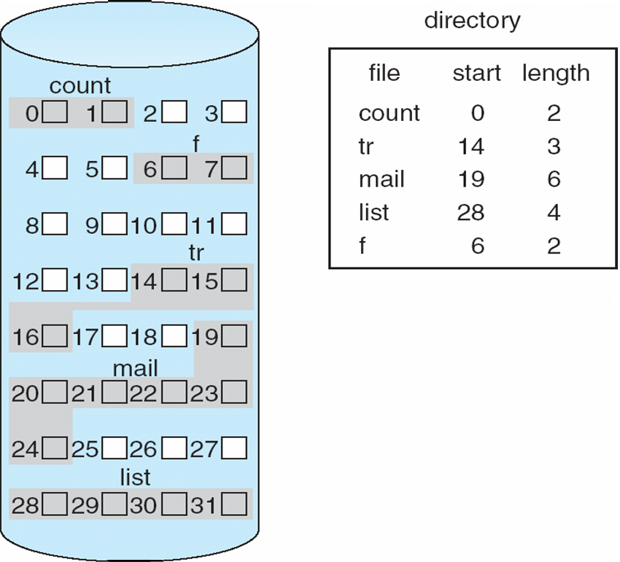
Ways to store files: Contiguous Allocation
Divide disk into fixed-sized blocks (usually 4KB)
One way to organize data region is by using contiguous blocks:
Extents describe start and length
Easy and fast to access and lookup data
Difficult to allocate space
Fragmentation

Slide 7
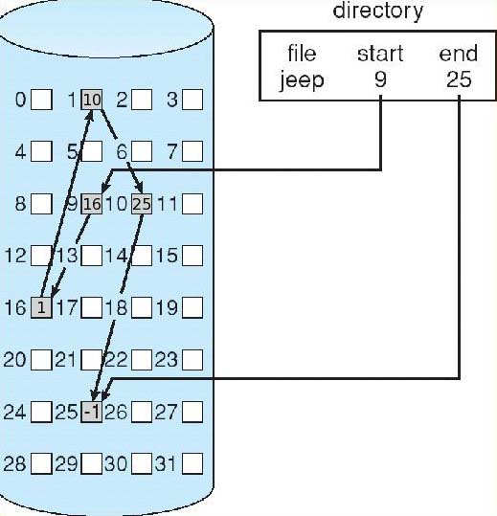
Ways to store files: Linked Allocation
Another way is to use a linked list.
Each block points to next block
Easy allocation
Poor random access
Can use file allocation table to store links
FAT

Slide 8
Ways to store files: Indexed Allocation
Another way is to use pointers to fixed size blocks
Easy allocation
Good random access
Overhead of pointers
Can have multiple levels of pointers
Data
Inode
Direct 0
Data
Direct 1
Direct 2
Direct 3
Indirect
Data
Unix way
Direct 0
Direct 1
Data

Slide 9
File System: Inodes
Inodes store administrative data about files:
Permissions
Owner, Group
File Size
Links – where is the data
Modification, Access, Status times
Where there is no file name in the inode?

Slide 10
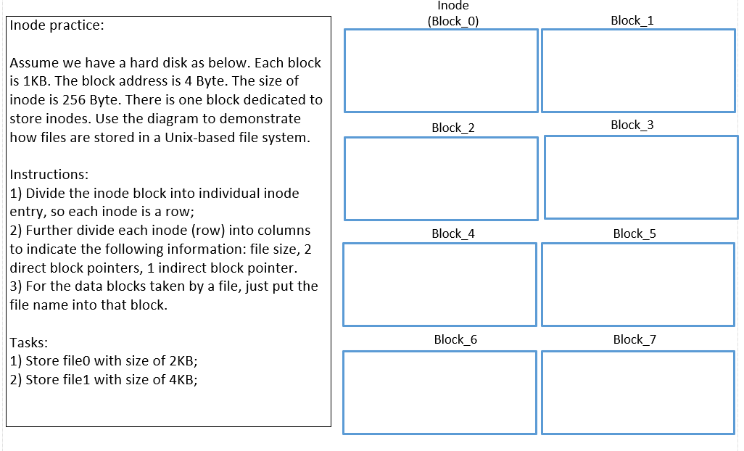
Inode Practice
Further questions:
Which data block is available?
Which inode is available?
Where are the inodes on storage?

